Slide 1
二维红外光谱 Two-dimensional Infrared Spectra
李由
2020年8月3日

Slide 2
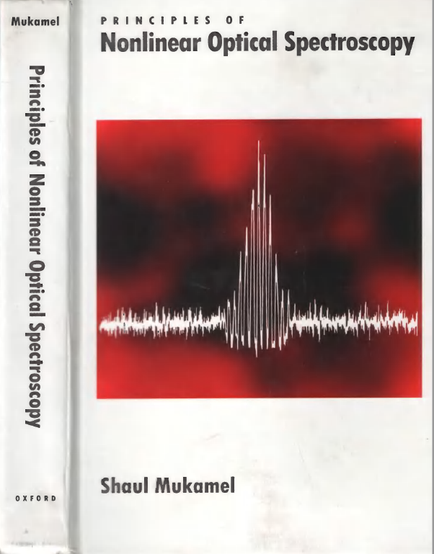
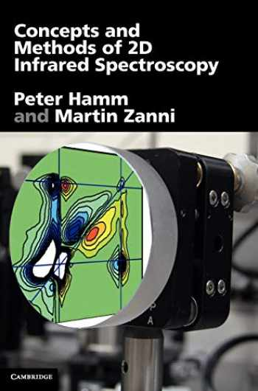
目录
1. 电场-偶极矩相互作用的非线性光学响应
2. 半经典近似及累积量展开
3. 二维红外光谱的计算

Slide 3
第一节
电场-偶极矩相互作用的非线性光学响应

Slide 4
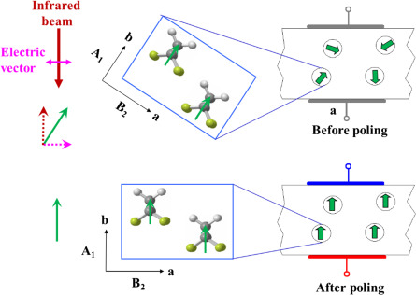
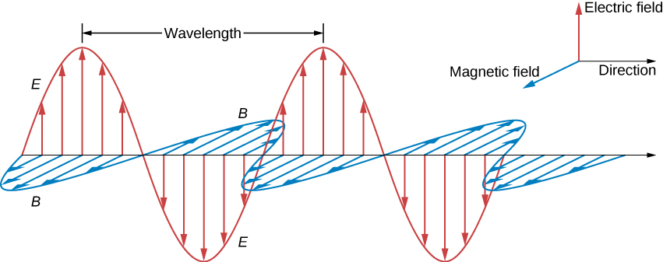
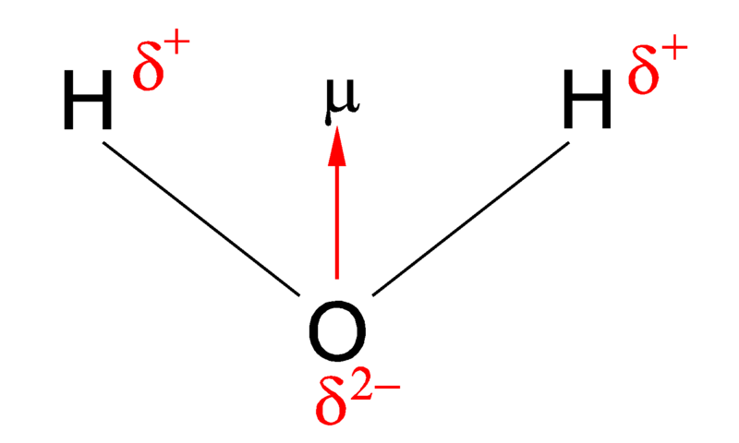
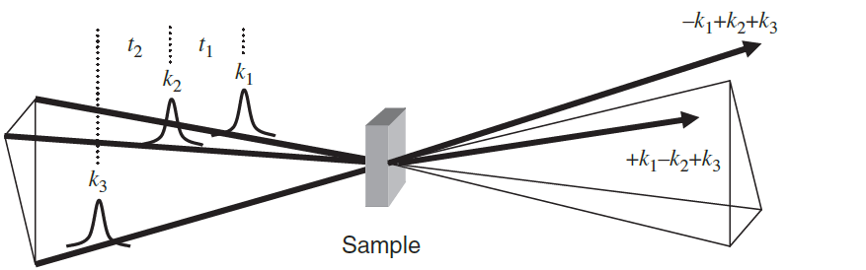
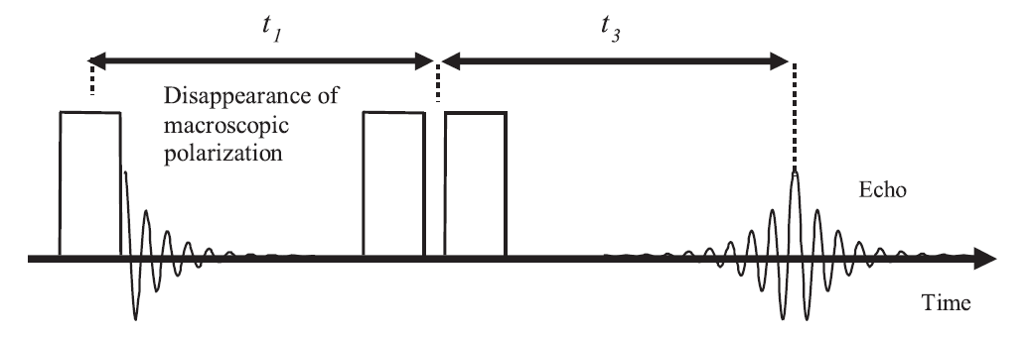
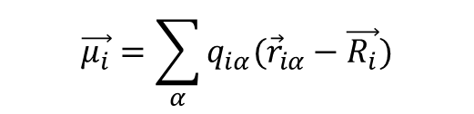
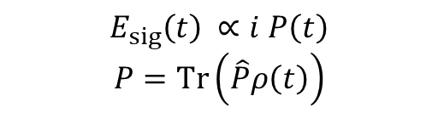
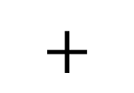
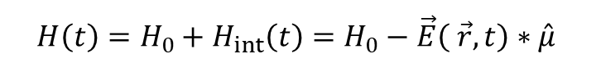
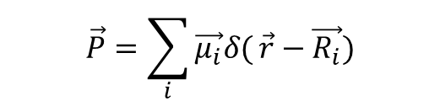
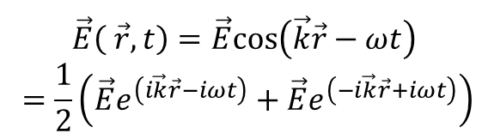
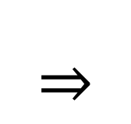
光与物质的相互作用
物质在电场下的极化：
$$+$$
$$\vec{E}\left( \vec{r},t\right)=\vec{E}cos\left(\vec{k}\vec{r}−ωt\right)$$
$$=\frac{1}{2}\left(\vec{E}e^{\left(i\vec{k}\vec{r}−iωt\right)}+\vec{E}e^{\left(−i\vec{k}\vec{r}+iωt\right)}\right)$$
$$\vec{μ_{i}}=\sum_{α}{q_{iα}({\vec{r}}_{iα}−\vec{R_{i}})}$$
$$\vec{P}=\sum_{i}{\vec{μ_{i}}δ(}\vec{r}−\vec{R_{i}})$$
经典电磁波
体系量子化
感应电场
含时微扰
$$E_{sig}\left(t\right) ∝i P\left(t\right)$$
$$P=Tr\left(\hat{P}ρ\left(t\right)\right)$$
$$H\left(t\right)=H_{0}+H_{int}\left(t\right)=H_{0}−\vec{E}\left( \vec{r},t\right)∗\hat{μ}$$

Slide 5
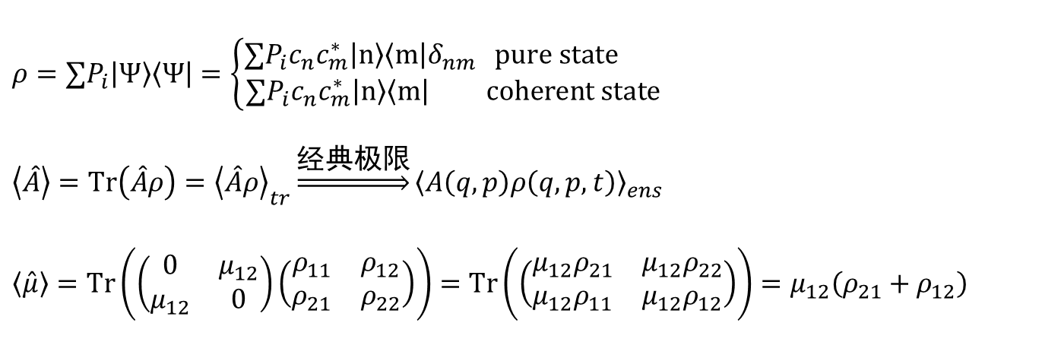
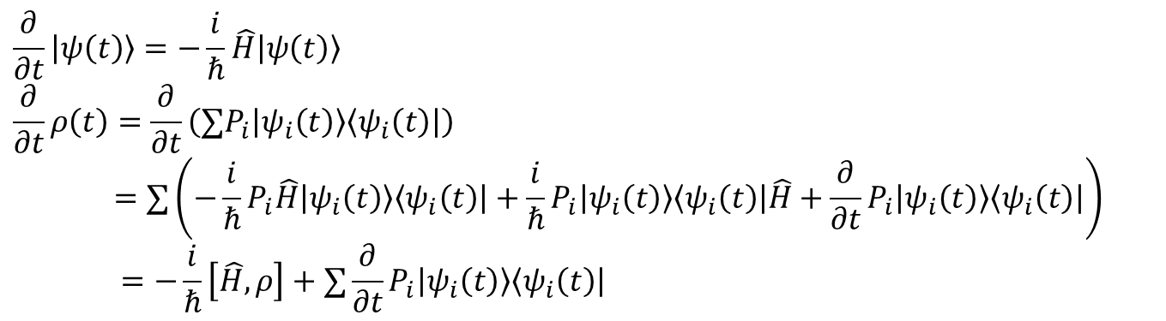
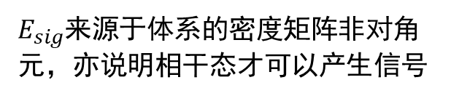
密度矩阵与量子统计
密度矩阵：
$$ρ=∑P_{i}\left|Ψ\right\rangle \left\langle Ψ\right|=\left\{\begin{aligned}∑{P_{i}c}_{n}c_{m}^{∗}\left|n\right\rangle \left\langle m\right|δ_{nm} pure state \\ ∑{P_{i}c}_{n}c_{m}^{∗}\left|n\right\rangle \left\langle m\right| coherent state \end{aligned}\right.$$
$$\left\langle \hat{A}\right\rangle =Tr\left(\hat{A}ρ\right)={\left\langle \hat{A}ρ\right\rangle }_{tr}\underset{⇒}{经典极限}{\left\langle A\left(q,p\right)ρ\left(q,p,t\right)\right\rangle }_{ens}$$
$$\left\langle \hat{μ}\right\rangle =Tr\left(\left(\begin{matrix}0 & μ_{12} \\ μ_{12} & 0\end{matrix}\right)\left(\begin{matrix}ρ_{11} & ρ_{12} \\ ρ_{21} & ρ_{22}\end{matrix}\right)\right)=Tr\left(\left(\begin{matrix}μ_{12}ρ_{21} & μ_{12}ρ_{22} \\ μ_{12}ρ_{11} & μ_{12}ρ_{12}\end{matrix}\right)\right)=μ_{12}\left(ρ_{21}+ρ_{12}\right)$$
$E_{sig}$来源于体系的密度矩阵非对角元，亦说明相干态才可以产生信号
密度矩阵的时间演化：(Liouville-von Neumann equation)
$$\frac{∂}{∂t}\left|ψ\left(t\right)\right\rangle =−\frac{i}{ℏ}\hat{H}\left|ψ\left(t\right)\right\rangle$$
$$\frac{∂}{∂t}ρ\left(t\right)=\frac{∂}{∂t}\left(∑P_{i}\left|ψ_{i}\left(t\right)\right\rangle \left\langle ψ_{i}\left(t\right)\right|\right)$$
$$=∑\left(−\frac{i}{ℏ}P_{i}\hat{H}\left|ψ_{i}\left(t\right)\right\rangle \left\langle ψ_{i}\left(t\right)\right|+\frac{i}{ℏ}P_{i}\left|ψ_{i}\left(t\right)\right\rangle \left\langle ψ_{i}\left(t\right)\right|\hat{H}+\frac{∂}{∂t}P_{i}\left|ψ_{i}\left(t\right)\right\rangle \left\langle ψ_{i}\left(t\right)\right|\right)$$
$$=−\frac{i}{ℏ}\left[\hat{H},ρ\right]+∑\frac{∂}{∂t}P_{i}\left|ψ_{i}\left(t\right)\right\rangle \left\langle ψ_{i}\left(t\right)\right|$$
包含population relaxation

Slide 6
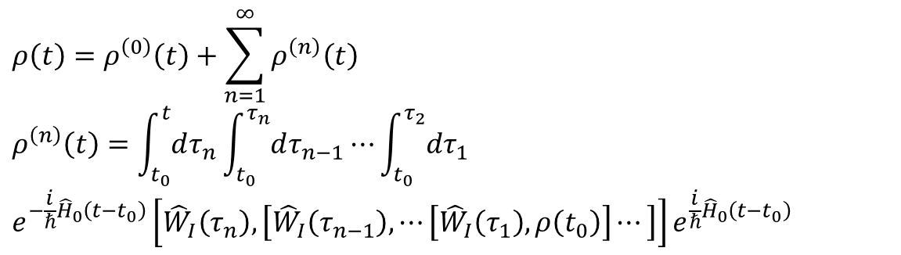
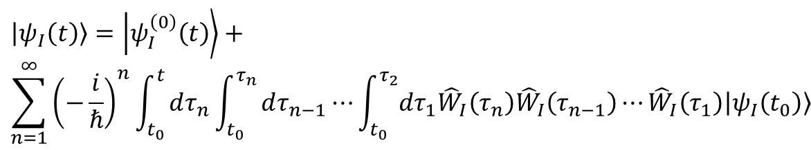
相互作用图像与含时微扰
相互作用图像(interaction picture)：
$$\left|ψ_{I}\left(t\right)\right\rangle =e^{\frac{i}{ℏ}{\hat{H}}_{0}\left(t−t_{0}\right)}\left|ψ\left(t\right)\right\rangle , \frac{∂}{∂t}\left|ψ_{I}\left(t\right)\right\rangle =−\frac{i}{ℏ}{\hat{W}}_{I}\left(t\right)\left|ψ_{I}\left(t\right)\right\rangle$$
${\hat{μ}}_{I}\left(t\right)=e^{\frac{i}{ℏ}{\hat{H}}_{0}\left(t−t_{0}\right)}\hat{μ}e^{−\frac{i}{ℏ}{\hat{H}}_{0}\left(t−t_{0}\right)}$ （后文中省略下标$I$）
相互作用图像下的含时微扰：
$$\left|ψ_{I}\left(t\right)\right\rangle =\left|ψ_{I}^{\left(0\right)}\left(t\right)\right\rangle +$$
$$\sum_{n=1}^{∞}{{\left(−\frac{i}{ℏ}\right)}^{n}\int_{t_{0}}^{t}{dτ_{n}\int_{t_{0}}^{τ_{n}}{dτ_{n−1}⋯\int_{t_{0}}^{τ_{2}}{dτ_{1}{\hat{W}}_{I}\left(τ_{n}\right){\hat{W}}_{I}\left(τ_{n−1}\right)}}}}⋯{\hat{W}}_{I}\left(τ_{1}\right)\left|ψ_{I}\left(t_{0}\right)\right\rangle$$
$$ρ\left(t\right)=ρ^{\left(0\right)}\left(t\right)+\sum_{n=1}^{∞}{ρ^{\left(n\right)}\left(t\right)}$$
$$ρ^{\left(n\right)}\left(t\right)=\int_{t_{0}}^{t}{dτ_{n}}\int_{t_{0}}^{τ_{n}}{dτ_{n−1}}⋯\int_{t_{0}}^{τ_{2}}{dτ_{1}}$$
$$e^{−\frac{i}{ℏ}{\hat{H}}_{0}\left(t−t_{0}\right)}\left[{\hat{W}}_{I}\left(τ_{n}\right),\left[{\hat{W}}_{I}\left(τ_{n−1}\right),⋯\left[{\hat{W}}_{I}\left(τ_{1}\right),ρ\left(t_{0}\right)\right]⋯\right]\right]e^{\frac{i}{ℏ}{\hat{H}}_{0}\left(t−t_{0}\right)}$$

Slide 7
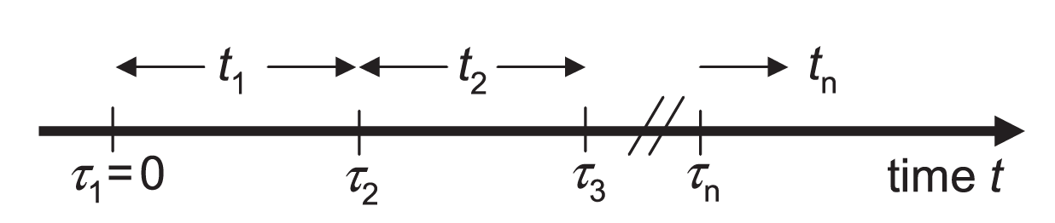
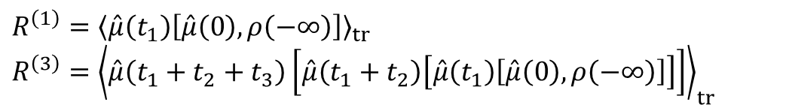
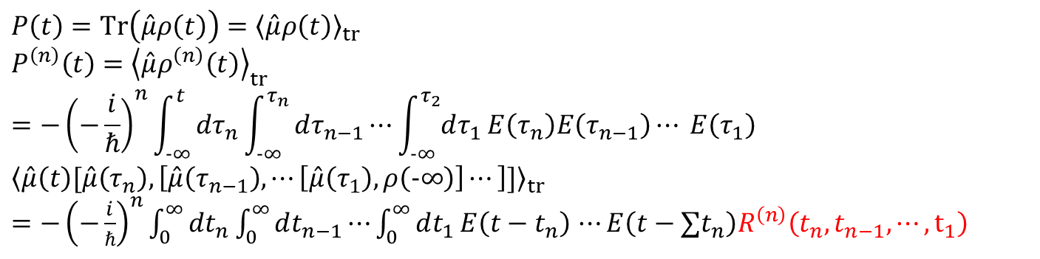
光电场极化的响应函数
电场极化：
极化算符：
$$P\left(t\right)=Tr\left(\hat{μ}ρ\left(t\right)\right)={\left\langle \hat{μ}ρ\left(t\right)\right\rangle }_{tr}$$
$$P^{\left(n\right)}\left(t\right)={\left\langle \hat{μ}ρ^{\left(n\right)}\left(t\right)\right\rangle }_{tr}$$
$$=−{\left(−\frac{i}{ℏ}\right)}^{n}\int_{−∞}^{t}{dτ_{n}\int_{−∞}^{τ_{n}}{dτ_{n−1}⋯\int_{−∞}^{τ_{2}}{dτ_{1}}}}E\left(τ_{n}\right)E\left(τ_{n−1}\right)⋯ E\left(τ_{1}\right)$$
$${\left\langle \hat{μ}\left(t\right)[\hat{μ}\left(τ_{n}\right),\left[\hat{μ}\left(τ_{n−1}\right),⋯\left[\hat{μ}\left(τ_{1}\right),ρ\left(−∞\right)\right]⋯\right]]\right\rangle }_{tr}$$
$=−{\left(−\frac{i}{ℏ}\right)}^{n}\int_{0}^{∞}{dt_{n}\int_{0}^{∞}{dt_{n−1}⋯\int_{0}^{∞}{dt_{1}}}}E\left(t−t_{n}\right)$ $⋯E\left(t−∑t_{n}\right)R^{\left(n\right)}\left(t_{n},t_{n−1},⋯,t_{1}\right)$
响应函数(response function):
$$R^{\left(1\right)}={\left\langle \hat{μ}\left(t_{1}\right)\left[\hat{μ}\left(0\right),ρ\left(−∞\right)\right]\right\rangle }_{tr}$$
$$R^{\left(3\right)}={\left\langle \hat{μ}\left(t_{1}+t_{2}+t_{3}\right)\left[\hat{μ}\left(t_{1}+t_{2}\right)\left[\hat{μ}\left(t_{1}\right)\left[\hat{μ}\left(0\right),ρ\left(−∞\right)\right]\right]\right]\right\rangle }_{tr}$$

Slide 8
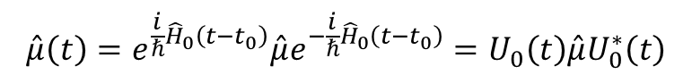
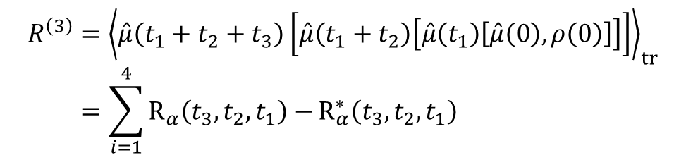
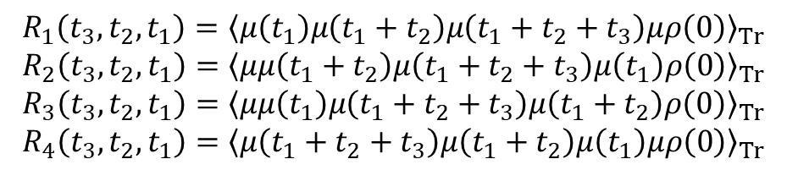
三阶非线性响应
全量子三阶响应函数：
交换反对称与轮换对称：
$$Tr\left(μ\left(t\right)μ\left(0\right)ρ\right)=Tr{\left(μ\left(0\right)μ\left(t\right)ρ\right)}^{∗}=Tr\left(μ\left(0\right)ρμ\left(t\right)\right)$$
相互作用表象下偶极矩：
$$\hat{μ}\left(t\right)=e^{\frac{i}{ℏ}{\hat{H}}_{0}\left(t−t_{0}\right)}\hat{μ}e^{−\frac{i}{ℏ}{\hat{H}}_{0}\left(t−t_{0}\right)}=U_{0}\left(t\right)\hat{μ}U_{0}^{∗}\left(t\right)$$
总三阶响应函数：
$$R^{\left(3\right)}={\left\langle \hat{μ}\left(t_{1}+t_{2}+t_{3}\right)\left[\hat{μ}\left(t_{1}+t_{2}\right)\left[\hat{μ}\left(t_{1}\right)\left[\hat{μ}\left(0\right),ρ\left(0\right)\right]\right]\right]\right\rangle }_{tr}$$
$$=\sum_{i=1}^{4}{R_{α}\left(t_{3},t_{2},t_{1}\right)−}R_{α}^{∗}\left(t_{3},t_{2},t_{1}\right)$$
$$R_{1}\left(t_{3},t_{2},t_{1}\right)={\left\langle μ\left(t_{1}\right)μ\left(t_{1}+t_{2}\right)μ\left(t_{1}+t_{2}+t_{3}\right)μρ\left(0\right)\right\rangle }_{Tr}$$
$$R_{2}\left(t_{3},t_{2},t_{1}\right)={\left\langle μμ\left(t_{1}+t_{2}\right)μ\left(t_{1}+t_{2}+t_{3}\right)μ\left(t_{1}\right)ρ\left(0\right)\right\rangle }_{Tr}$$
$$R_{3}\left(t_{3},t_{2},t_{1}\right)={\left\langle μμ\left(t_{1}\right)μ\left(t_{1}+t_{2}+t_{3}\right)μ\left(t_{1}+t_{2}\right)ρ\left(0\right)\right\rangle }_{Tr}$$
$$R_{4}\left(t_{3},t_{2},t_{1}\right)={\left\langle μ\left(t_{1}+t_{2}+t_{3}\right)μ\left(t_{1}+t_{2}\right)μ\left(t_{1}\right)μρ\left(0\right)\right\rangle }_{Tr}$$

Slide 9
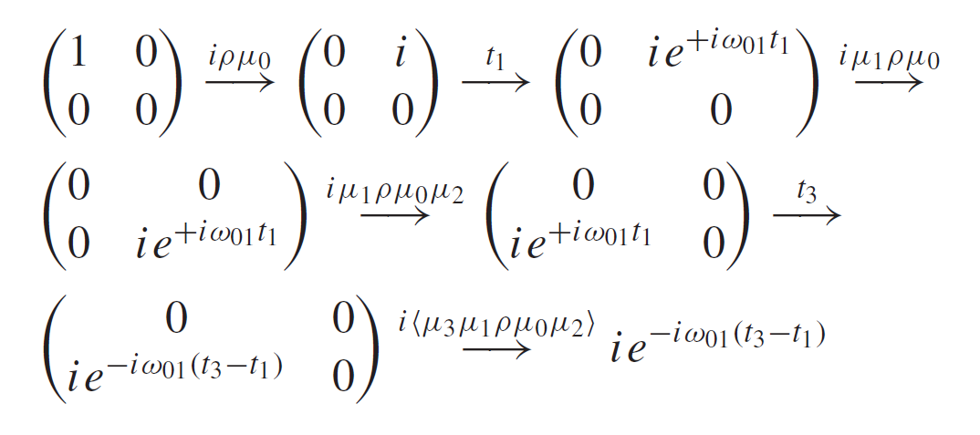
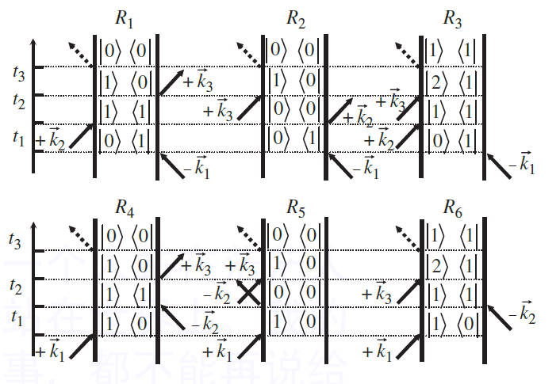
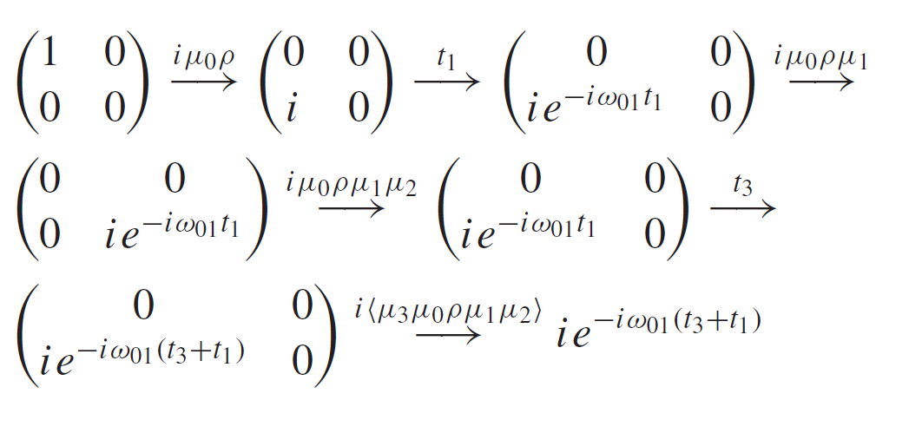
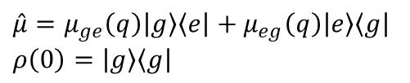
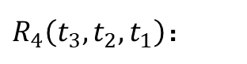
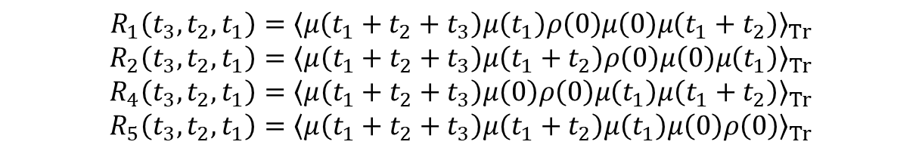
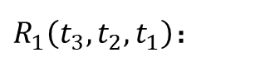
Double sided Feynman diagrams
全量子三阶响应函数反应路径：
$$\hat{μ}=μ_{ge}\left(q\right)\left|g\right\rangle \left\langle e\right|+μ_{eg}\left(q\right)\left|e\right\rangle \left\langle g\right|$$
$$ρ\left(0\right)=\left|g\right\rangle \left\langle g\right|$$
$$R_{1}\left(t_{3},t_{2},t_{1}\right)={\left\langle μ\left(t_{1}+t_{2}+t_{3}\right)μ\left(t_{1}\right)ρ\left(0\right)μ\left(0\right)μ\left(t_{1}+t_{2}\right)\right\rangle }_{Tr}$$
$$R_{2}\left(t_{3},t_{2},t_{1}\right)={\left\langle μ\left(t_{1}+t_{2}+t_{3}\right)μ\left(t_{1}+t_{2}\right)ρ\left(0\right)μ\left(0\right)μ\left(t_{1}\right)\right\rangle }_{Tr}$$
$$R_{4}\left(t_{3},t_{2},t_{1}\right)={\left\langle μ\left(t_{1}+t_{2}+t_{3}\right)μ\left(0\right)ρ\left(0\right)μ\left(t_{1}\right)μ\left(t_{1}+t_{2}\right)\right\rangle }_{Tr}$$
$$R_{5}\left(t_{3},t_{2},t_{1}\right)={\left\langle μ\left(t_{1}+t_{2}+t_{3}\right)μ\left(t_{1}+t_{2}\right)μ\left(t_{1}\right)μ\left(0\right)ρ\left(0\right)\right\rangle }_{Tr}$$
$R_{1}\left(t_{3},t_{2},t_{1}\right)$：
rephasing
$R_{4}\left(t_{3},t_{2},t_{1}\right)$：
Non-rephasing
Double-sided Feynman diagrams

Slide 10
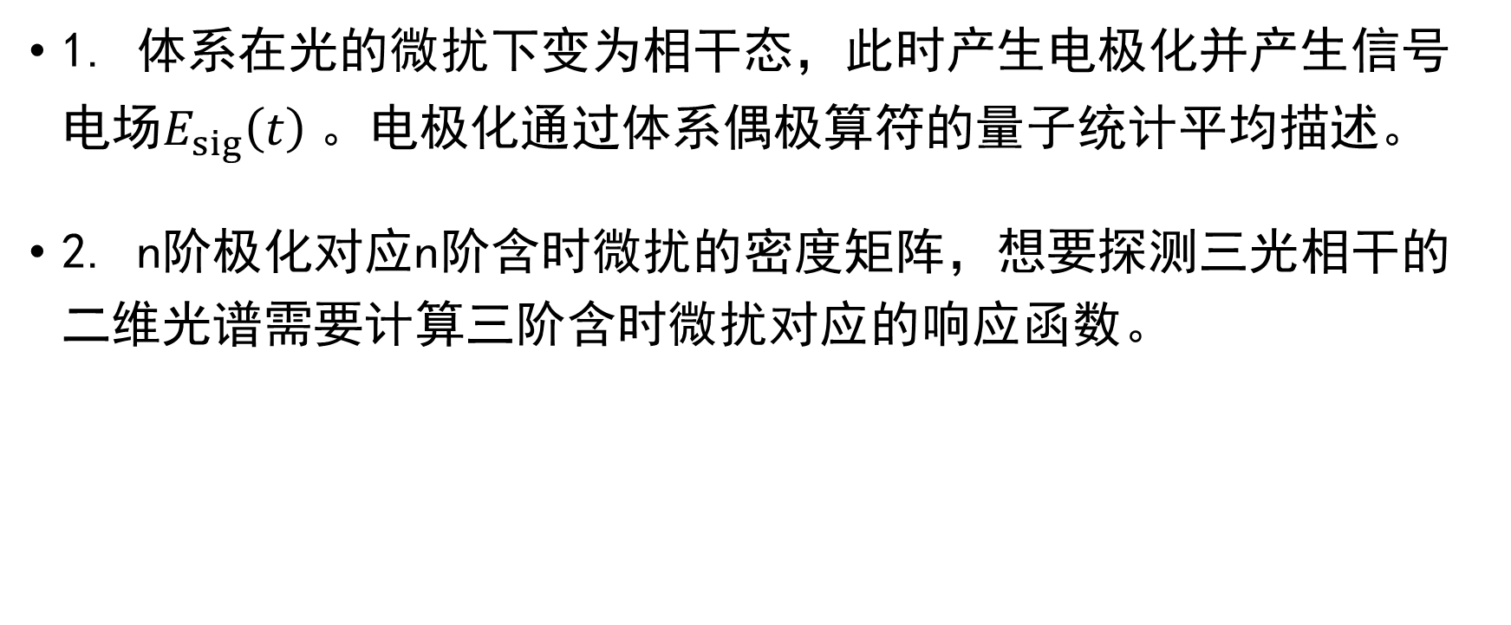
小结
1. 体系在光的微扰下变为相干态，此时产生电极化并产生信号电场$E_{sig}\left(t\right)$。电极化通过体系偶极算符的量子统计平均描述。
2. n阶极化对应n阶含时微扰的密度矩阵，想要探测三光相干的二维光谱需要计算三阶含时微扰对应的响应函数。

Slide 11
第二节
半经典近似及累积量展开

Slide 12
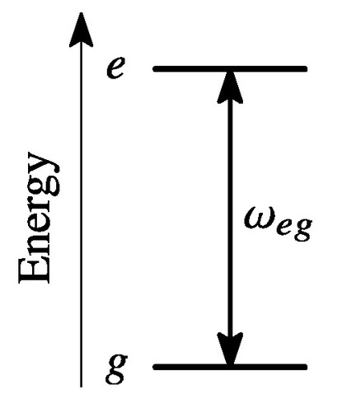
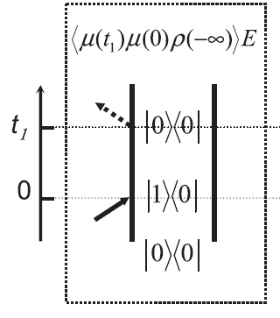
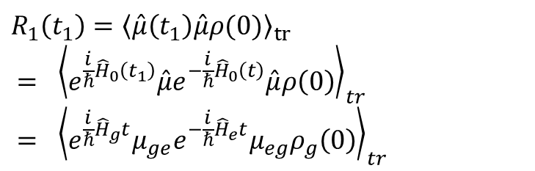
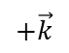
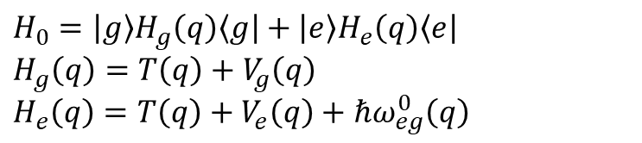
双能级体系线性响应函数
双能级体系哈密顿量：
$$H_{0}=\left|g\right\rangle H_{g}\left(q\right)\left\langle g\right|+\left|e\right\rangle H_{e}\left(q\right)\left\langle e\right|$$
$$H_{g}\left(q\right)=T\left(q\right)+V_{g}\left(q\right)$$
$$H_{e}\left(q\right)=T\left(q\right)+V_{e}\left(q\right)+ℏω_{eg}^{0}\left(q\right)$$
跃迁偶极：
$$\hat{μ}=μ_{ge}\left(q\right)\left|g\right\rangle \left\langle e\right|+μ_{eg}\left(q\right)\left|e\right\rangle \left\langle g\right|$$
一阶响应函数：
$$R_{1}\left(t_{1}\right)={\left\langle \hat{μ}\left(t_{1}\right)\hat{μ}ρ(0)\right\rangle }_{tr}$$
$$= {\left\langle e^{\frac{i}{ℏ}{\hat{H}}_{0}\left(t_{1}\right)}\hat{μ}e^{−\frac{i}{ℏ}{\hat{H}}_{0}\left(t\right)}\hat{μ}ρ\left(0\right)\right\rangle }_{tr}$$
$$= {\left\langle e^{\frac{i}{ℏ}{\hat{H}}_{g}t}μ_{ge}e^{−\frac{i}{ℏ}{\hat{H}}_{e}t}μ_{eg}ρ_{g}\left(0\right)\right\rangle }_{tr}$$
$$+\vec{k}$$
Double-sided Feynman diagrams

Slide 13
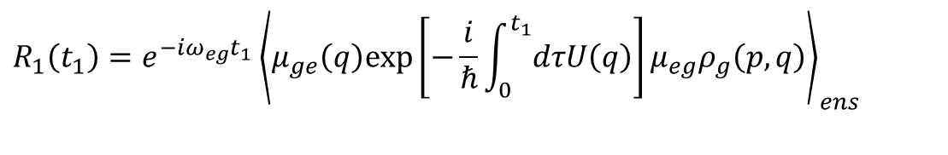
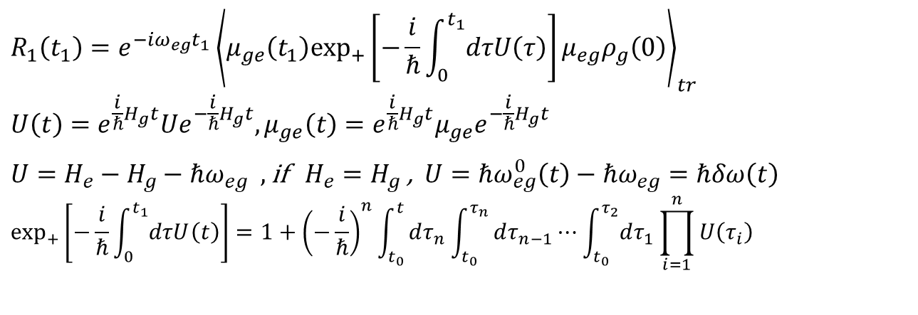
线性响应函数的半经典近似
时序算符替换：
$$R_{1}\left(t_{1}\right)=e^{−iω_{eg}t_{1}}{\left\langle μ_{ge}\left(t_{1}\right)\exp_{+}\left[−\frac{i}{ℏ}\int_{0}^{t_{1}}{dτU\left(τ\right)}\right]μ_{eg}ρ_{g}\left(0\right)\right\rangle }_{tr}$$
$$U\left(t\right)=e^{\frac{i}{ℏ}H_{g}t}Ue^{−\frac{i}{ℏ}H_{g}t},μ_{ge}\left(t\right)=e^{\frac{i}{ℏ}H_{g}t}μ_{ge}e^{−\frac{i}{ℏ}H_{g}t}$$
$U=H_{e}−H_{g}−ℏω_{eg} ,$ if $H_{e}=H_{g}$ , $U=ℏω_{eg}^{0}\left(t\right)−ℏω_{eg}=ℏδω\left(t\right)$
$$\exp_{+}\left[−\frac{i}{ℏ}\int_{0}^{t_{1}}{dτU\left(t\right)}\right]=1+{\left(−\frac{i}{ℏ}\right)}^{n}\int_{t_{0}}^{t}{dτ_{n}\int_{t_{0}}^{τ_{n}}{dτ_{n−1}⋯\int_{t_{0}}^{τ_{2}}{dτ_{1}}}}\prod_{i=1}^{n}{U\left(τ_{i}\right)}$$
基态演化：
电子能差：
Time-order exponential:
半经典近似：
$$R_{1}\left(t_{1}\right)=e^{−iω_{eg}t_{1}}{\left\langle μ_{ge}\left(q\right)exp\left[−\frac{i}{ℏ}\int_{0}^{t_{1}}{dτU\left(q\right)}\right]μ_{eg}ρ_{g}\left(p,q\right)\right\rangle }_{ens}$$
经典动力学演化的跃迁距
经典系综平均
经典动力学演化的频率位移
能级计算仍处于量子力学水平

Slide 14
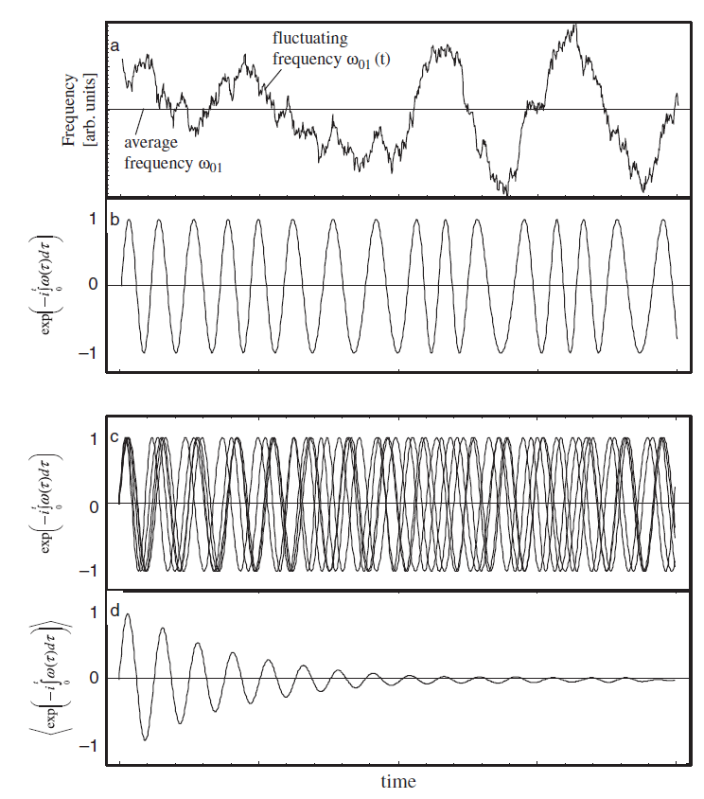
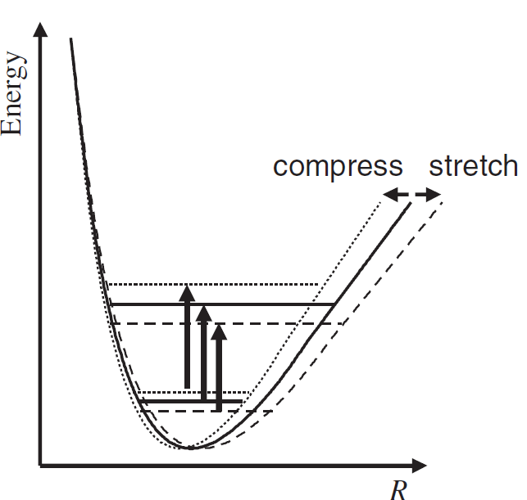
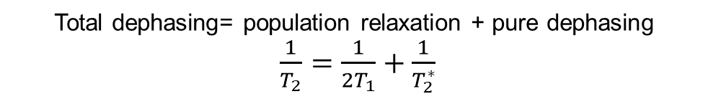
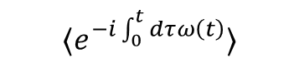

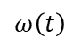
Pure dephasing
Total dephasing= population relaxation + pure dephasing
$\frac{1}{T_{2}}=\frac{1}{2T_{1}}+\frac{1}{T_{2}^{∗}}$
$$e^{−i\int_{0}^{t}{dτ}ω\left(t\right)}$$
$$ω\left(t\right)$$
$$⟨e^{−i\int_{0}^{t}{dτ}ω\left(t\right)}⟩$$
子体系的能级差随外界环境变化
这是pure dephasing的本质

Slide 15
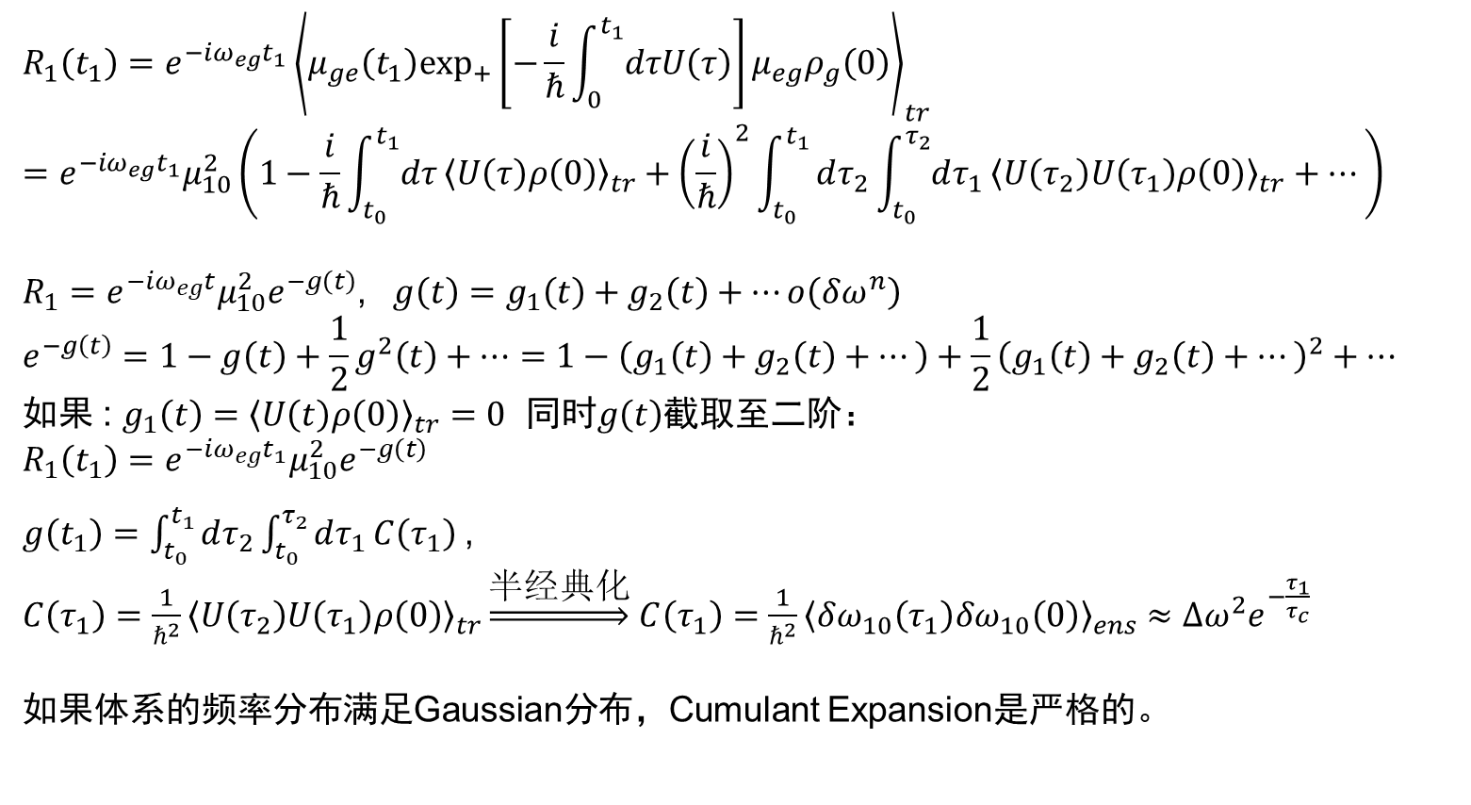
累积量展开
时序算符展开：
$$R_{1}\left(t_{1}\right)=e^{−iω_{eg}t_{1}}{\left\langle μ_{ge}\left(t_{1}\right)\exp_{+}\left[−\frac{i}{ℏ}\int_{0}^{t_{1}}{dτU\left(τ\right)}\right]μ_{eg}ρ_{g}\left(0\right)\right\rangle }_{tr}$$
$$=e^{−iω_{eg}t_{1}}μ_{10}^{2}\left(1−\frac{i}{ℏ}\int_{t_{0}}^{t_{1}}{dτ}{\left\langle U\left(τ\right)ρ\left(0\right)\right\rangle }_{tr}+{\left(\frac{i}{ℏ}\right)}^{2}\int_{t_{0}}^{t_{1}}{dτ_{2}\int_{t_{0}}^{τ_{2}}{dτ_{1}}}{\left\langle U\left(τ_{2}\right)U\left(τ_{1}\right)ρ\left(0\right)\right\rangle }_{tr}+…\right)$$
${R_{1}=e}^{−iω_{eg}t}μ_{10}^{2}e^{−g\left(t\right)}$, $g\left(t\right)=g_{1}\left(t\right)+g_{2}\left(t\right)+…o\left(δω^{n}\right)$
$$e^{−g\left(t\right)}=1−g\left(t\right)+\frac{1}{2}g^{2}\left(t\right)+…=1−\left(g_{1}\left(t\right)+g_{2}\left(t\right)+…\right)+\frac{1}{2}{\left(g_{1}\left(t\right)+g_{2}\left(t\right)+…\right)}^{2}+…$$
如果 : $g_{1}\left(t\right)={\left\langle U\left(t\right)ρ\left(0\right)\right\rangle }_{tr}=0$ 同时$g\left(t\right)$截取至二阶：
$$R_{1}\left(t_{1}\right)=e^{−iω_{eg}t_{1}}μ_{10}^{2}e^{−g\left(t\right)}$$
$g\left(t_{1}\right)=\int_{t_{0}}^{t_{1}}{dτ_{2}\int_{t_{0}}^{τ_{2}}{dτ_{1}}}C\left(τ_{1}\right)$,
$C\left(τ_{1}\right)=\frac{1}{ℏ^{2}}{\left\langle U\left(τ_{2}\right)U\left(τ_{1}\right)ρ\left(0\right)\right\rangle }_{tr}\underset{⇒}{半经典化}$ $C\left(τ_{1}\right)=\frac{1}{ℏ^{2}}{\left\langle δω_{10}\left(τ_{1}\right)δω_{10}\left(0\right)\right\rangle }_{ens}≈Δω^{2}e^{−\frac{τ_{1}}{τ_{c}}}$
如果体系的频率分布满足Gaussian分布，Cumulant Expansion是严格的。
Condon近似：
假设：
Frequency fluctuation correlation function

Slide 16
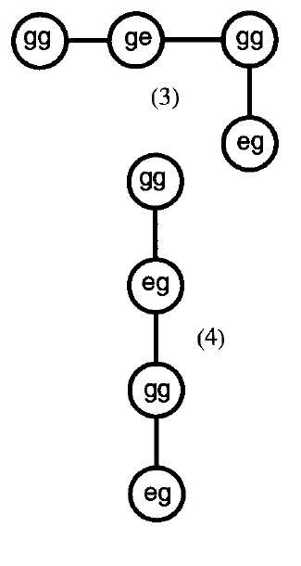
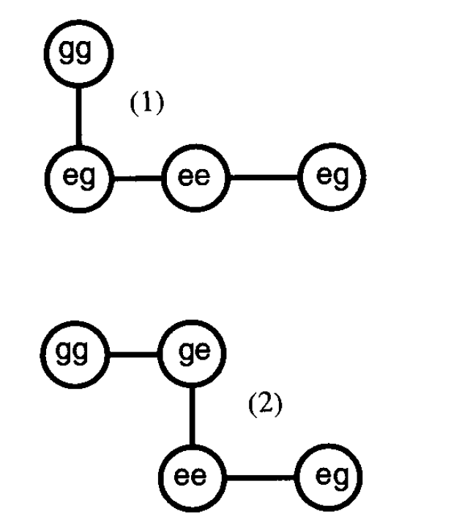
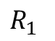
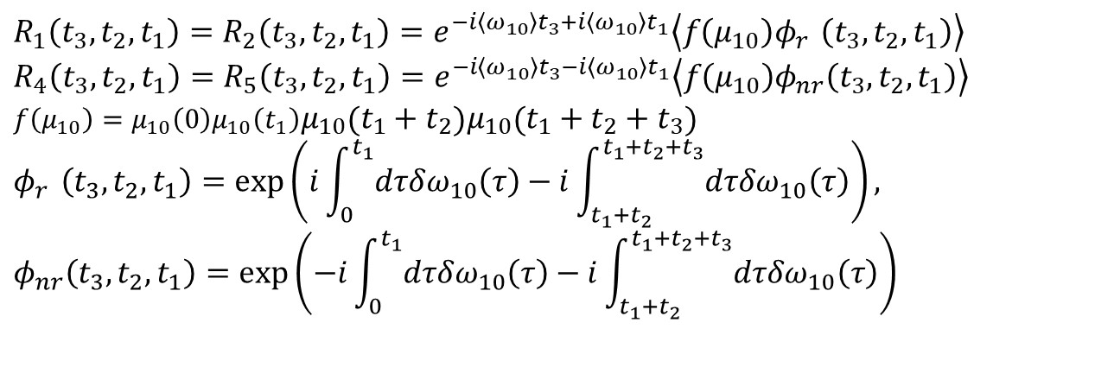




三阶响应半经典近似
$$\vec{E}\left( \vec{r},t\right) =\frac{1}{2}\left(\vec{E}e^{\left(i\vec{k}\vec{r}−iωt\right)}+\vec{E}e^{\left(−i\vec{k}\vec{r}+iωt\right)}\right)$$
双能级三阶响应函数：
rephasing：
$$R_{1}\left(t_{3},t_{2},t_{1}\right)=R_{2}\left(t_{3},t_{2},t_{1}\right)=e^{−i\left\langle ω_{10}\right\rangle t_{3}+i\left\langle ω_{10}\right\rangle t_{1}}\left\langle f\left(μ_{10}\right)φ_{r}^{}\left(t_{3},t_{2},t_{1}\right)\right\rangle$$
$$R_{4}\left(t_{3},t_{2},t_{1}\right)=R_{5}\left(t_{3},t_{2},t_{1}\right)=e^{−i\left\langle ω_{10}\right\rangle t_{3}−i\left\langle ω_{10}\right\rangle t_{1}}\left\langle f\left(μ_{10}\right)φ_{nr}^{}\left(t_{3},t_{2},t_{1}\right)\right\rangle$$
$$f\left(μ_{10}\right)=μ_{10}\left(0\right)μ_{10}\left(t_{1}\right)μ_{10}\left(t_{1}+t_{2}\right)μ_{10}\left(t_{1}+t_{2}+t_{3}\right)$$
$$φ_{r}^{}\left(t_{3},t_{2},t_{1}\right)=exp\left(i\int_{0}^{t_{1}}{dτδω_{10}\left(τ\right)}−i\int_{t_{1}+t_{2}}^{t_{1}+t_{2}+t_{3}}{dτ{δω}_{10}\left(τ\right)}\right),$$
$$φ_{nr}^{}\left(t_{3},t_{2},t_{1}\right)=exp\left(−i\int_{0}^{t_{1}}{dτδω_{10}\left(τ\right)}−i\int_{t_{1}+t_{2}}^{t_{1}+t_{2}+t_{3}}{dτ{δω}_{10}\left(τ\right)}\right)$$
Non-rephasing：
stimulated emission：
Ground state
bleaching：
$$R_{2}$$
rephasing
$$R_{1}$$
$$R_{5}$$
Non-rephasing
$$R_{4}$$
Liouville space pathway
Double-sided Feynman diagrams

Slide 17




三阶响应半经典近似
第二激发态响应函数：
rephasing：
$$R_{3}\left(t_{3},t_{2},t_{1}\right)=−e^{−i\left\langle ω_{21}\right\rangle t_{3}+i\left\langle ω_{10}\right\rangle t_{1}}\left\langle f\left(μ_{10},μ_{21}\right)ψ_{r}^{}\left(t_{3},t_{2},t_{1}\right)\right\rangle$$
$$R_{6}\left(t_{3},t_{2},t_{1}\right)={−e}^{−i\left\langle ω_{21}\right\rangle t_{3}−i\left\langle ω_{10}\right\rangle t_{1}}\left\langle f\left(μ_{10},μ_{21}\right)ψ_{nr}^{}\left(t_{3},t_{2},t_{1}\right)\right\rangle$$
$$f\left(μ_{10}\right)=μ_{10}\left(0\right)μ_{10}\left(t_{1}\right)μ_{21}\left(t_{1}+t_{2}\right)μ_{21}\left(t_{1}+t_{2}+t_{3}\right)$$
$$ψ_{r}^{}\left(t_{3},t_{2},t_{1}\right)=exp\left(i\int_{0}^{t_{1}}{dτδω_{10}\left(τ\right)}−i\int_{t_{1}+t_{2}}^{t_{1}+t_{2}+t_{3}}{dτ{δω}_{21}\left(τ\right)}\right),$$
$$ψ_{nr}^{}\left(t_{3},t_{2},t_{1}\right)=exp\left(−i\int_{0}^{t_{1}}{dτδω_{10}\left(τ\right)}−i\int_{t_{1}+t_{2}}^{t_{1}+t_{2}+t_{3}}{dτ{δω}_{21}\left(τ\right)}\right)$$
Non-rephasing：
transient absorption：
$$R_{3}$$
rephasing
fe
$$R_{6}$$
Non-rephasing
fe
Double-sided Feynman diagrams

Slide 18

三阶响应函数累计展开近似
三阶响应函数的累计展开：
rephasing：
$$R_{r}\left(t_{3},t_{2},t_{1}\right)=2μ_{10}^{4}e^{−i\left\langle ω_{10}\right\rangle t_{3}+i\left\langle ω_{10}\right\rangle t_{1}}e^{G_{1}\left(t_{3},t_{2},t_{1}\right)}{−μ_{10}^{2}μ_{21}^{2}e}^{−i\left\langle ω_{21}\right\rangle t_{3}+i\left\langle ω_{10}\right\rangle t_{1}}e^{G_{2}\left(t_{3},t_{2},t_{1}\right)}$$
$$R_{nr}\left(t_{3},t_{2},t_{1}\right)=2μ_{10}^{4}e^{−i\left\langle ω_{10}\right\rangle t_{3}−i\left\langle ω_{10}\right\rangle t_{1}}e^{G_{3}\left(t_{3},t_{2},t_{1}\right)}{−μ_{10}^{2}μ_{21}^{2}e}^{−i\left\langle ω_{21}\right\rangle t_{3}−i\left\langle ω_{10}\right\rangle t_{1}}e^{G_{4}\left(t_{3},t_{2},t_{1}\right)}$$
$$G_{1}=−g_{11}\left(t_{1}\right)+g_{11}\left(t_{2}\right)−g_{11}\left(t_{3}\right)−g_{11}\left(t_{1}+t_{2}\right)−g_{11}\left(t_{2}+t_{3}\right)+g_{11}\left(t_{1}+t_{2}+t_{3}\right)$$
$$G_{2}=−g_{11}\left(t_{1}\right)+g_{12}\left(t_{2}\right)−g_{22}\left(t_{3}\right)−g_{12}\left(t_{1}+t_{2}\right)−g_{12}\left(t_{2}+t_{3}\right)+g_{12}\left(t_{1}+t_{2}+t_{3}\right)$$
$$G_{3}=−g_{11}\left(t_{1}\right)−g_{11}\left(t_{2}\right)−g_{11}\left(t_{3}\right)+g_{11}\left(t_{1}+t_{2}\right)+g_{11}\left(t_{2}+t_{3}\right)−g_{11}\left(t_{1}+t_{2}+t_{3}\right)$$
$$G_{4}=−g_{11}\left(t_{1}\right)−g_{12}\left(t_{2}\right)−g_{22}\left(t_{3}\right)+g_{12}\left(t_{1}+t_{2}\right)+g_{12}\left(t_{2}+t_{3}\right)−g_{12}\left(t_{1}+t_{2}+t_{3}\right)$$
$$g_{ij}\left(t_{1}\right)=\int_{t_{0}}^{t_{1}}{dτ_{2}\int_{t_{0}}^{τ_{2}}{dτ_{1}}}C_{ij}\left(τ_{1}\right)$$
$$C_{ij}\left(t\right)=\left\langle δω_{i}\left(t\right) δω_{j}\left(0\right)\right\rangle$$
Non-rephasing：

Slide 19
第三节
二维红外光谱计算

Slide 20


计算参数
System : HOD vibration in H2O
Total time : 1 ns
$dt$in $R_{r},R_{nr}$ calculation: 0.04 ps
Time average : almost 0.8ns
$dt$in Time average : 0.4 ps
Anharmonic vibration has same frequency fluctuation:$δω_{21}\left(t\right)=δω_{10}\left(t\right)$

Slide 21



三阶响应函数
三阶响应函数($T_{2}$=0)：
Rephasing函数实部
Rephasing函数虚部

Slide 22



三阶响应函数
三阶响应函数($T_{2}$=0) ：
Non-rephasing函数实部
Non-rephasing函数虚部

Slide 23






$T_{2}$时间的spectral diffusion
$$φ_{r}^{}\left(t_{3},t_{2},t_{1}\right)=exp\left(i\int_{0}^{t_{1}}{dτδω_{10}\left(τ\right)}−i\int_{t_{1}+t_{2}}^{t_{1}+t_{2}+t_{3}}{dτ{δω}_{10}\left(τ\right)}\right),$$
$$φ_{nr}^{}\left(t_{3},t_{2},t_{1}\right)=exp\left(−i\int_{0}^{t_{1}}{dτδω_{10}\left(τ\right)}−i\int_{t_{1}+t_{2}}^{t_{1}+t_{2}+t_{3}}{dτ{δω}_{10}\left(τ\right)}\right)$$
二维红外光谱：
$T_{2}$= 0 fs
$T_{2}$= 400 fs

Slide 24





三阶响应函数
$T_{2}$=400fs：
Rephasing和non-rephasing实部
Rephasing和non-rephasing虚部

Slide 25




累积量展开
频率相关函数：
频率$相关函数\left\langle δω\left(t\right)ω\left(0\right)\right\rangle$
$T_{2}$=0时红外光谱

Slide 26


Chemical exchange
Artificial frequency shift after 10ps：
频率分布
频率-时间关系

Slide 27











Chemical exchange
$T_{2}$=0ps
$T_{2}$=5ps
$T_{2}$=10ps
$T_{2}$=2ps
$T_{2}$=7ps
Waiting time $T_{2}$

Slide 28




HCl体系
频率相关函数：
频率$相关函数\left\langle δω\left(t\right)ω\left(0\right)\right\rangle$
$T_{2}$=0时红外光谱

Slide 29



HCl体系
频率分布：
频率变化
$$频率分布$$

Slide 30


NMA-dimer体系
频率分布：
频率变化
$$频率分布$$

Slide 31


乙腈液相体系
频率分布：
频率变化
$$频率分布$$

Slide 32


甲酸-水溶液体系
频率分布：
频率变化
$$频率分布$$

Slide 33



甲酸-水溶液体系
频率分布：
频率变化
$$频率变化$$

Slide 34



甲酸-水溶液体系
频率相关函数：
10ps轨迹
$2$ps轨迹

